Slide 1
Help Wanted Online A real-time measure of job postings
April 2023
Office of Research Connecticut Department of Labor
Connecticut Department of Labor – Research Office 200 Folly Brook Blvd. Wethersfield, CT 06109
Help Wanted Online

Slide 2
What is HWOL?
The Conference Board Help Wanted Online® Data Series (HWOL) measures the number of new, first-time Online job postings and jobs reposted from the previous month for over 50,000 Internet job boards, corporate boards and smaller job sites that serve niche markets and smaller geographic areas. This document contains information on monthly total job ad counts for March 2023.
Connecticut Department of Labor – Research Office 200 Folly Brook Blvd. Wethersfield, CT 06109
Help Wanted Online

Slide 3
Upcoming Release Dates
Monthly Report: April, 12th, 2023 Weekly New Ads Report: Updated every Friday
Connecticut Department of Labor – Research Office 200 Folly Brook Blvd. Wethersfield, CT 06109
Help Wanted Online

Slide 4
Statewide Monthly Highlights
- Total postings in Connecticut was 83,808 in March 2023, up 18% from February 2023. -Industry sectors with the most job postings were Health Care and Social Assistance (20,782 postings), Retail Trade (7,187 posting), Manufacturing (7,168 postings), and Finance & Insurance (6,280 postings).
-Occupations with the most postings were Registered Nurses (5,557 postings), Retail Salespersons (2,457 postings), Managers (2,002 postings), and Wholesale & Manufacturing Sales Reps. (1,875 postings),
Connecticut Department of Labor – Research Office 200 Folly Brook Blvd. Wethersfield, CT 06109
Help Wanted Online

Slide 5
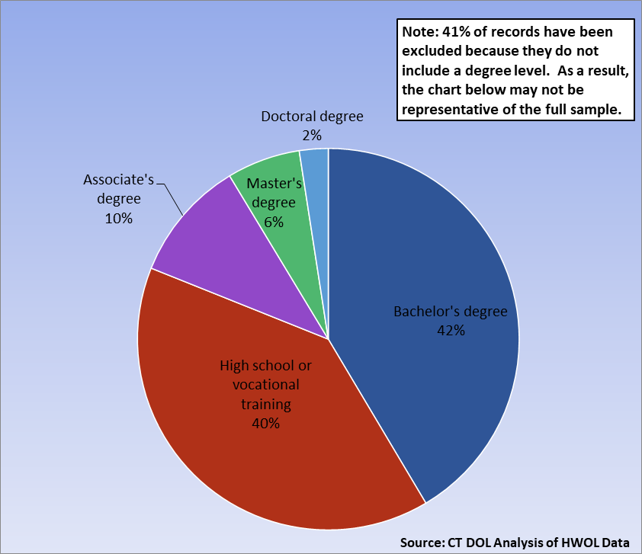
Connecticut Job Ads by Educational Requirements
Connecticut Department of Labor – Research Office 200 Folly Brook Blvd. Wethersfield, CT 06109
Help Wanted Online

Slide 6
Top Certifications in Connecticut Job Ads
Connecticut Department of Labor – Research Office 200 Folly Brook Blvd. Wethersfield, CT 06109
Help Wanted Online

Slide 7
Top Skills in Connecticut Job Ads
Connecticut Department of Labor – Research Office 200 Folly Brook Blvd. Wethersfield, CT 06109
Help Wanted Online

Slide 8
Top Skills by Industry in Connecticut Job Ads
Connecticut Department of Labor – Research Office 200 Folly Brook Blvd. Wethersfield, CT 06109
Help Wanted Online

Slide 9
Top Skills by Industry in Connecticut Job Ads (Continued)
Connecticut Department of Labor – Research Office 200 Folly Brook Blvd. Wethersfield, CT 06109
Help Wanted Online

Slide 10
Connecticut Department of Labor – Research Office 200 Folly Brook Blvd. Wethersfield, CT 06109
Help Wanted Online

Slide 11
Connecticut Employers with the Most Job Ads
Connecticut Department of Labor – Research Office 200 Folly Brook Blvd. Wethersfield, CT 06109
Help Wanted Online

Slide 12
Connecticut Occupations with the Most Job Ads
Connecticut Department of Labor – Research Office 200 Folly Brook Blvd. Wethersfield, CT 06109
Help Wanted Online

Slide 13
Connecticut Job Ads by Industry and Major Occupational Group
Connecticut Department of Labor – Research Office 200 Folly Brook Blvd. Wethersfield, CT 06109
Help Wanted Online

Slide 14
Workforce Area Data
Workforce Area Highlights
Job Ads by Industry
Job Ads by Location
Employers With The Most Job Ads
Occupations With The Most Job Ads
Connecticut Department of Labor – Research Office 200 Folly Brook Blvd. Wethersfield, CT 06109
Help Wanted Online

Slide 15
Workforce Area Highlights
Connecticut Department of Labor – Research Office 200 Folly Brook Blvd. Wethersfield, CT 06109
Help Wanted Online

Slide 16
Connecticut Department of Labor – Research Office 200 Folly Brook Blvd. Wethersfield, CT 06109
Help Wanted Online

Slide 17
Eastern Workforce Job Ads by Location
Connecticut Department of Labor – Research Office 200 Folly Brook Blvd. Wethersfield, CT 06109
Help Wanted Online

Slide 18
Eastern Workforce Employers
with the Most Job Ads
Connecticut Department of Labor – Research Office 200 Folly Brook Blvd. Wethersfield, CT 06109
Help Wanted Online

Slide 19
Eastern Workforce Occupations
with the Most Job Ads
Connecticut Department of Labor – Research Office 200 Folly Brook Blvd. Wethersfield, CT 06109
Help Wanted Online

Slide 20
Connecticut Department of Labor – Research Office 200 Folly Brook Blvd. Wethersfield, CT 06109
Help Wanted Online
20

Slide 21
North Central WDA Job Ads by Location
Connecticut Department of Labor – Research Office 200 Folly Brook Blvd. Wethersfield, CT 06109
Help Wanted Online

Slide 22
North Central WDA Employers
with the Most Job Ads
Connecticut Department of Labor – Research Office 200 Folly Brook Blvd. Wethersfield, CT 06109
Help Wanted Online

Slide 23
North Central WDA Occupations
with the Most Job Ads
Connecticut Department of Labor – Research Office 200 Folly Brook Blvd. Wethersfield, CT 06109
Help Wanted Online

Slide 24
Connecticut Department of Labor – Research Office 200 Folly Brook Blvd. Wethersfield, CT 06109
Help Wanted Online

Slide 25
Northwest WDA Job Ads by Location
Connecticut Department of Labor – Research Office 200 Folly Brook Blvd. Wethersfield, CT 06109
Help Wanted Online

Slide 26
Northwest WDA Employers
with the Most Job Ads
Connecticut Department of Labor – Research Office 200 Folly Brook Blvd. Wethersfield, CT 06109
Help Wanted Online

Slide 27
Northwest WDA Occupations
with the Most Job Ads
Connecticut Department of Labor – Research Office 200 Folly Brook Blvd. Wethersfield, CT 06109
Help Wanted Online

Slide 28
Connecticut Department of Labor – Research Office 200 Folly Brook Blvd. Wethersfield, CT 06109
Help Wanted Online

Slide 29
South Central WDA Job Ads by Location
Connecticut Department of Labor – Research Office 200 Folly Brook Blvd. Wethersfield, CT 06109
Help Wanted Online

Slide 30
South Central WDA Employers
with the Most Job Ads
Connecticut Department of Labor – Research Office 200 Folly Brook Blvd. Wethersfield, CT 06109
Help Wanted Online

Slide 31
South Central WDA Occupations
with the Most Job Ads
Connecticut Department of Labor – Research Office 200 Folly Brook Blvd. Wethersfield, CT 06109
Help Wanted Online

Slide 32
Connecticut Department of Labor – Research Office 200 Folly Brook Blvd. Wethersfield, CT 06109
Help Wanted Online

Slide 33
Southwest WDA Job Ads by Location
Connecticut Department of Labor – Research Office 200 Folly Brook Blvd. Wethersfield, CT 06109
Help Wanted Online

Slide 34
Southwest WDA Employers
with the Most Job Ads
Connecticut Department of Labor – Research Office 200 Folly Brook Blvd. Wethersfield, CT 06109
Help Wanted Online

Slide 35
Southwest WDA Occupations
with the Most Job Ads
Connecticut Department of Labor – Research Office 200 Folly Brook Blvd. Wethersfield, CT 06109
Help Wanted Online

Slide 36
All advertisement data used in this publication is from the Conference Board’s Help Wanted Online data series.
For more information or data requests, contact Matthew Krzyzek in the Office of Research at the Department of Labor.
Matthew.Krzyzek@ct.gov
For more Connecticut Labor Market Information visit:
www.ctdol.state.ct.us/lmi
https://www.facebook.com/ctlmi
Twitter: @DOL_Research
Connecticut Department of Labor – Research Office 200 Folly Brook Blvd. Wethersfield, CT 06109
Help Wanted Online

